Slide 1


COLLABORATION CURES

Slide 2
COLLABORATION CURES 2024 BANNER

Slide 3








AAPMD CHAPTERS
MEET AAPMD COLLABORATIVE CHAPTERS
BREATHE OUTLOOK
PHYSICAL THERAPY
AAPMD LIAISONS
ENDEAVOUR GROUP
AAPMD practitioners from around the world working to further the knowledge base, build relationships within their local community, and deliver a collaborative approach for optimal patient care.
Empower new discoveries through multi-center research projects with The Breathe Institute.
Early recognition, diagnosis & optimal treatment of sleep and breathing disorders focusing on children under 71 months.
Airway centered physical therapy to support the airway through body mechanics, behavior, posture, ergonomics, and breathing mechanics.
OROFACIAL MYOFUNCTIONAL THERAPY
FUNCTIONAL MEDICINE
RESTORATIVE DENTISTRY
SOCIAL
JUSTICE
The role of neuromuscular re-education of the craniofacial respiratory complex that supports breathing, speech, swallowing, chewing, and oral sensory normalization.
Creating a bridge between practitioners to identify and treat the root causes of disorders to achieve optimal results.
Every dental procedure may influence the airway for better or worse. Understand and institute protocols that will protect and restore airway structure and function
“Airway for All”. It is essential that all those in need for a better airway have a pathway for access to screening, diagnosis and treatment
More Info:
WWW.AAPMD.ORG
Notes:
THIS NEEDS A NEW GRAPHIC WITH ADDED SECTIONS (ENT)

Slide 4
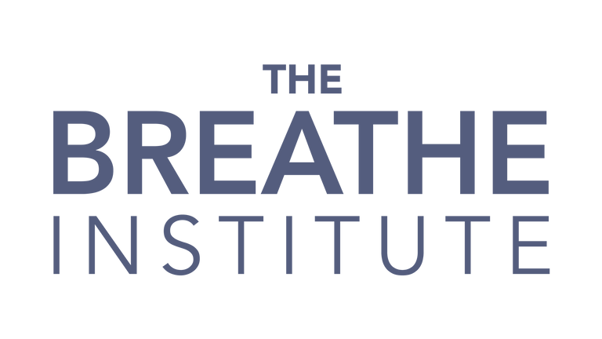

+
join
LIAISONS
us
Highlighting local community interdisciplinary practitioner groups and
developing best practices for collaboration.
THE AAPMD LIAISONS ARE A SELECT GROUP OF HEALTHCARE PROFESSIONALS WHO ARE ARDENTLY EXCITED ABOUT AIRWAY HEALTH, TASKED TO HELP SPREAD THE WORD ABOUT THE AAPMD’S MISSION AND LEARNING OPPORTUNITIES, SUCH AS THE UPCOMING 2023 COLLABORATION CURES SUMMIT SEPTEMBER 2024, LOCATION TBD.

Slide 5
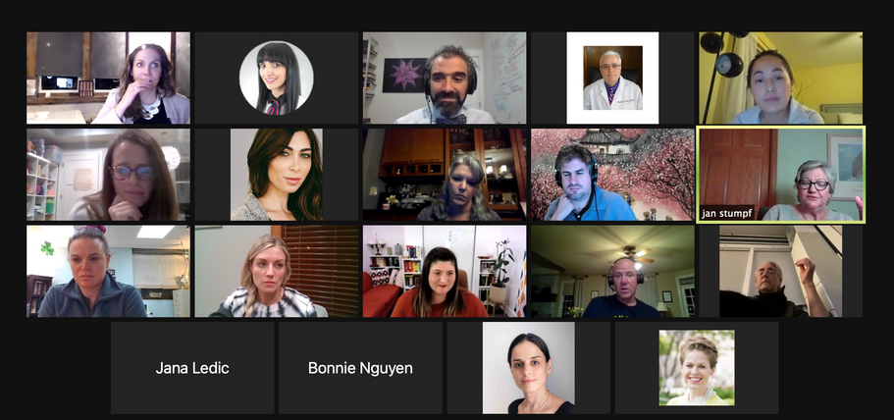
+
join
AIRWAY CoLAB
us
GLOBAL VIRTUAL NETWORK & STUDY COLLABORATIVE LED BY AAPMD LIAISONS
The AAPMD Liaisons volunteer committee are thrilled to be working with The Breathe Institute to build collaborative teams all around the world! 0ur collective goal is to further the knowledge base, build relationships with the community, and deliver a collaborative approach for optimal patient care. Through active participation, and inspiring demonstrations of initiative and motivation, our AAPMD Airway Liaison Chapter Presidents have shown their ability to effect positive change in their practices and communities by bringing together and collaborating with other seasoned and emerging leaders in the field.
OUR MISSION IS ACCOMPLISHED BY:
  RECRUITMENT, RESOURCES, AND EDUCATION FOR LIKE-MINDED PROVIDERS
  DEVELOPMENT OF AN EDUCATED REFERRAL NETWORK
  IMPROVED COMMUNICATION METHODS FOR INTERDISCIPLINARY CARE TEAMS
  COLLABORATION ON PATIENT CASES
  ADVOCACY AND AWARENESS FOR THE PUBLIC

Slide 6
PRESENTING
TO LOCAL PROVIDERS

Slide 7
YOUR NAME
CREDENTIALS /TITLE
BIO
-
-
-
-
-

Slide 8
AIRWAY HEALTH IN THE PEDIATRIC POPULATION

Slide 9
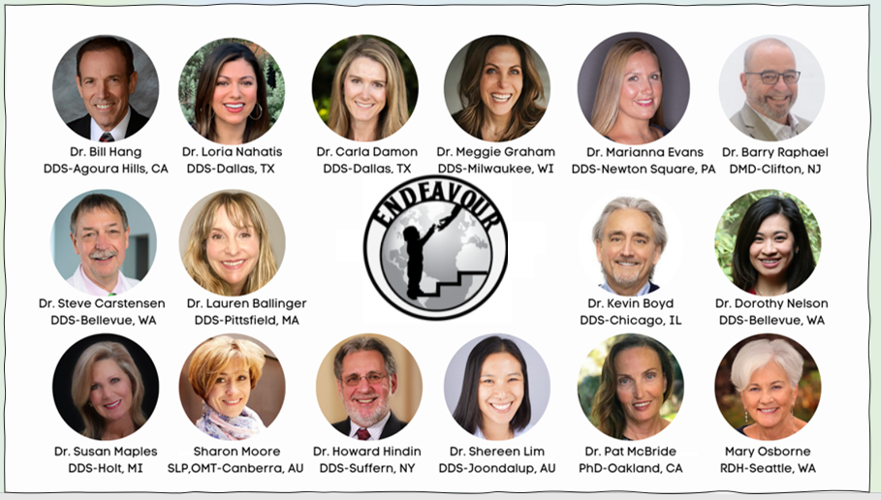
The AAPMD Endeavour Group

Slide 10
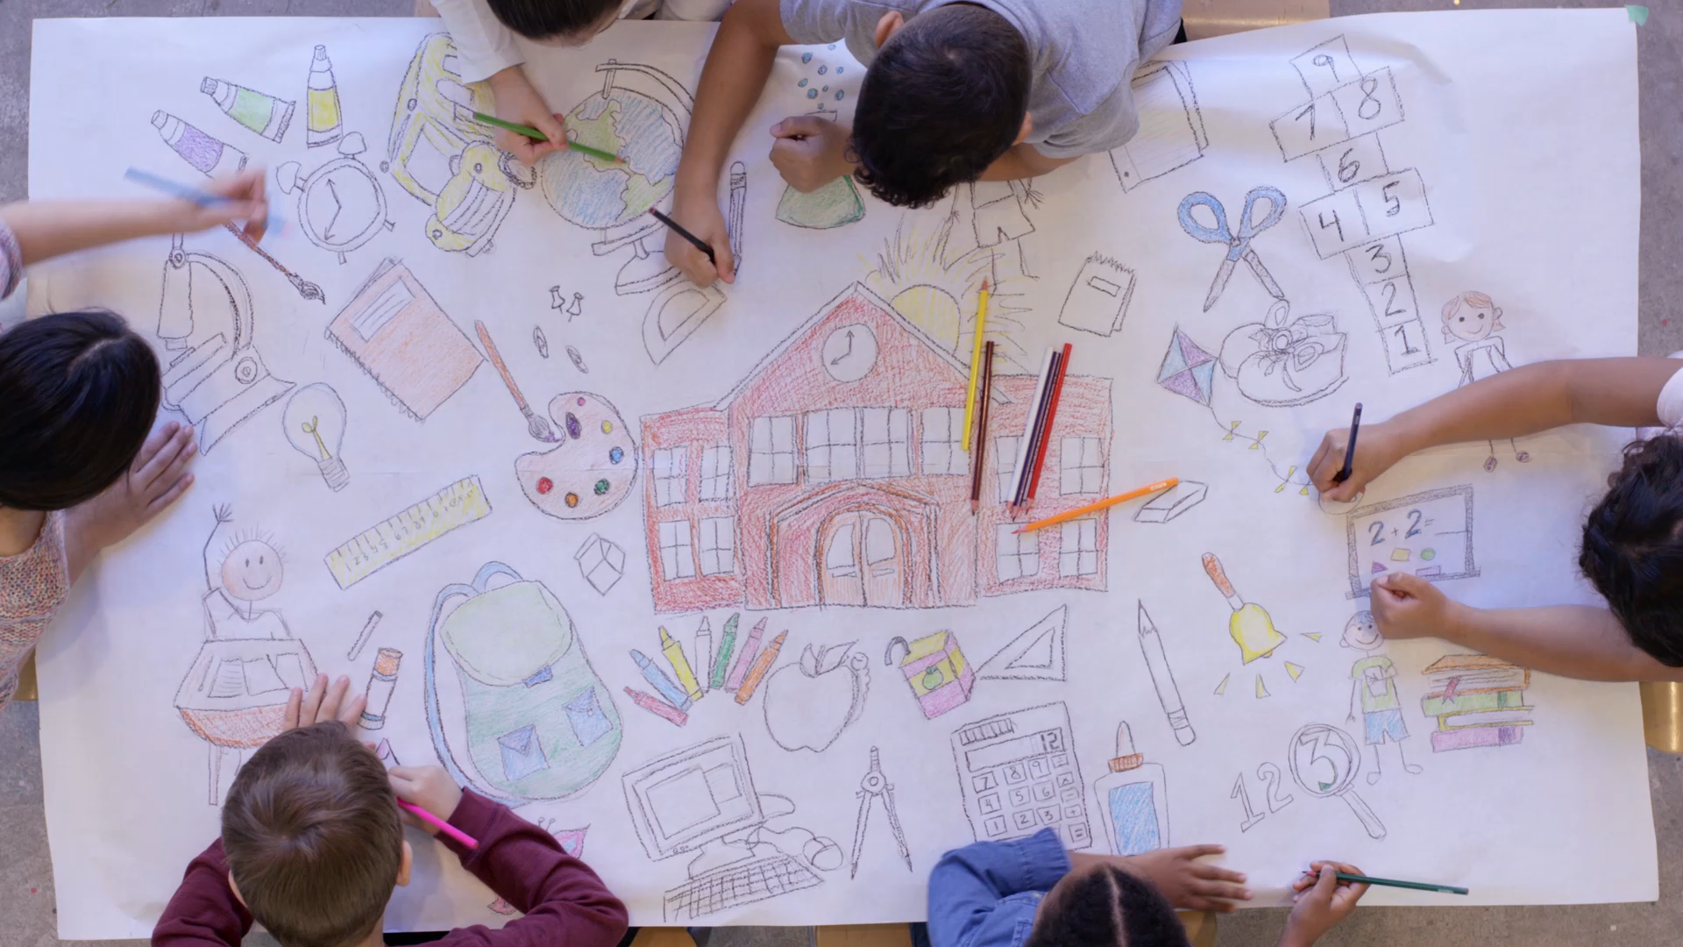
ENDEAVOUR’S FOCUS
CHILDREN
71 MONTHS AND YOUNGER

Slide 11
Who We Are
A group of like-minded professionals who find synergy and shared enthusiasm for taking on a project aimed at changing the health of our community by bringing a powerful preventive message to the world
Endeavour came together during the pandemic shut down. It allowed a passionate few to brainstorm ideas for influencing other professionals. Soon, it became a small group of committed leaders from around the world
Endeavour is a think tank, a guiding force for healthcare professional education under the umbrella of AAPMD. With that platform, we will create a path to move providers from ‘curious’ to ‘advanced’ so every community has resources to improve general health

Slide 12


ENDEAVOUR - Three Pillars
Elimination of Cranio-Facial Upper Airway Dysfunction
Elimination of Early Childhood Malocclusion
Elimination of Early Childhood Caries
Creating the BEST Possible Airway at the Earliest Possible Age
So Kids Breathe, Eat, Sleep and Thrive

Slide 13
Ensuring little people with airway issues do not grow into big people with airway issues
ENDEAVOUR
VISION
  A world where communities of children thrive from birth with optimum orofacial and upper airway health
MISSON
  Create a worldwide community of people committed to helping children grow and develop into healthy adults through elimination of ECC, ECM, EUAD
PURPOSE
  We believe in a world where children have the opportunity to be their BEST: breathe, eat, sleep and thrive

Slide 14
FAQ
HOW CAN I JOIN THE ENDEAVOUR?
Endeavour is not a membership group, but an idea. Once you believe you are a force for health in your community for children under 71 months old, you are part of Endeavour. Join the AAPMD, learn, and be a change agent.
Visit the Endeavour Section on the AAPMD website for the latest information, updates, research and events.

Slide 15


What We Do
Provide the place for professionals and members of the public to find everything related to AIRWAY HEALTH in the PEDIATRIC POPULATION
Build treatment communities for children around the world
Highlight past and present research and facilitate future research, as it relates to the pediatric population
Develop collaborative pathways with other health professionals who are necessary for optimal outcomes
Create a path for dentists to move from CURIOUS to ADVANCED so that every community has a dental provider who can appropriately and expertly QUARTERBACK treatment for the kids who need us

Slide 16
What We Do
FOCUS on the root causes of PREVENTABLE childhood illness, especially as it relates to IMMUNITY: nasal breathing, restful sleep, nutrition, inflammation
Fulfill our ROLE, OBLIGATION AND CONTRIBUTION as Dental Professionals
  To participate in the education, screening diagnosis, and treatment protocols related to the Cranio-Facial and Upper Respiratory Complex
Acknowledge adults with airway & sleep disorders began as children with airway & sleep disorders and that the #1 risk factor for the development of pediatric OSA is cranio-facial structure - and this can be modified
Emphasize the need for COLLABORATIVE and MULTIDISCIPLINARY TREATMENT TEAMS

Slide 17

How We Do It
ENDEAVOUR is collaborating with the AAPMD and others
Who are concerned about children under 71 months old
“As early in life as possible” only comes once. Health patterns are set pre-birth and during those formative months
To provide the screening tools to identify health risks for little ones
There are simple ways to help children and their caregivers recognize small problems
AAPMD and Endeavour can help you be a greater health advocate in your practice
Grow your knowledge and you will never see small kids the same way again

Slide 18
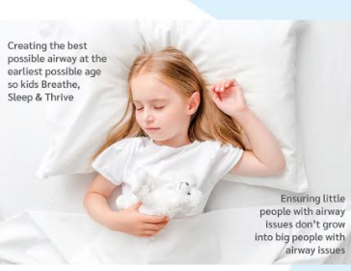

Slide 19
OROFACIAL
MYOFUNCTIONAL THERAPY

Slide 20
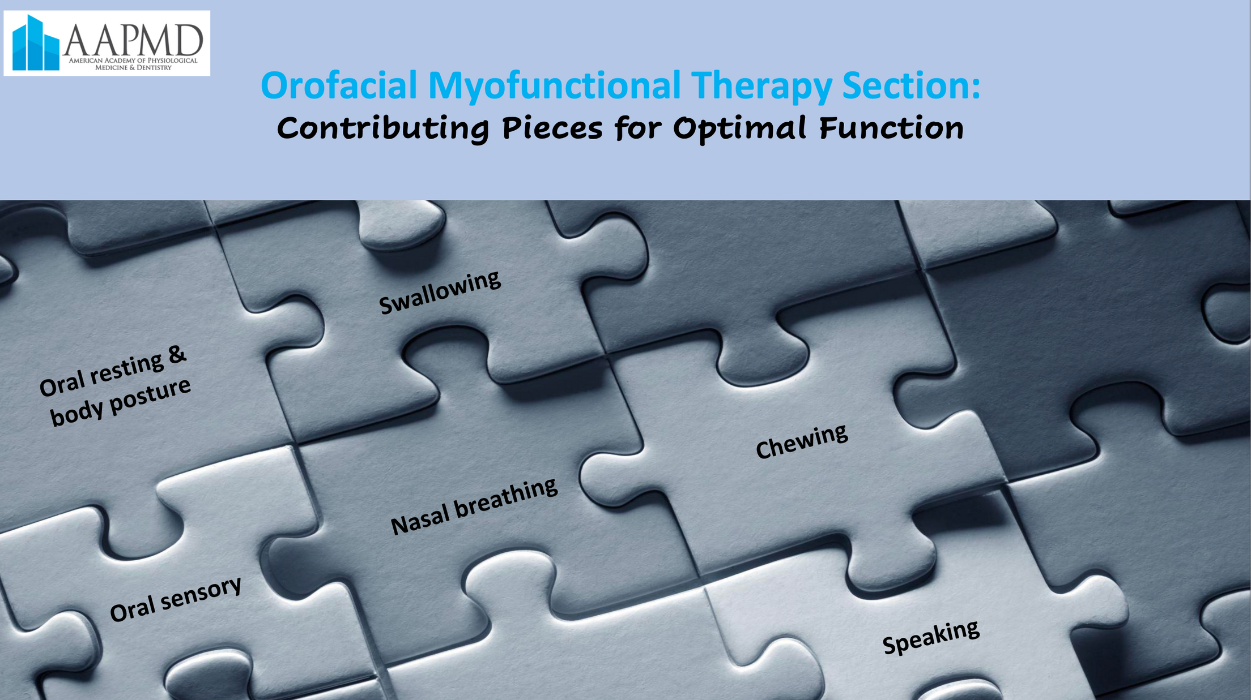

Slide 21
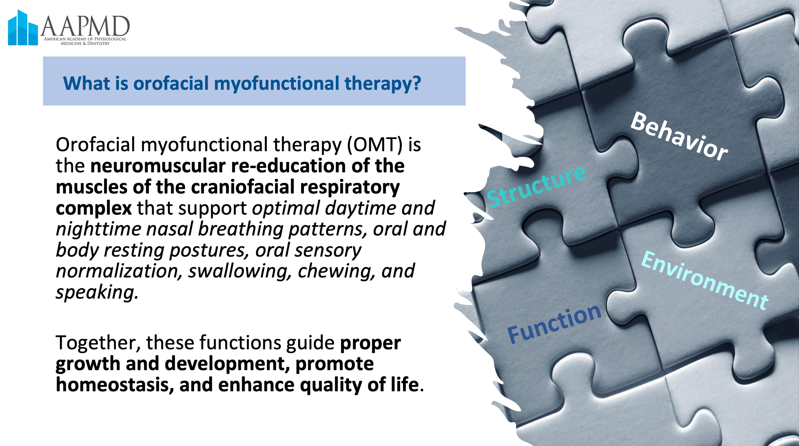

Slide 22
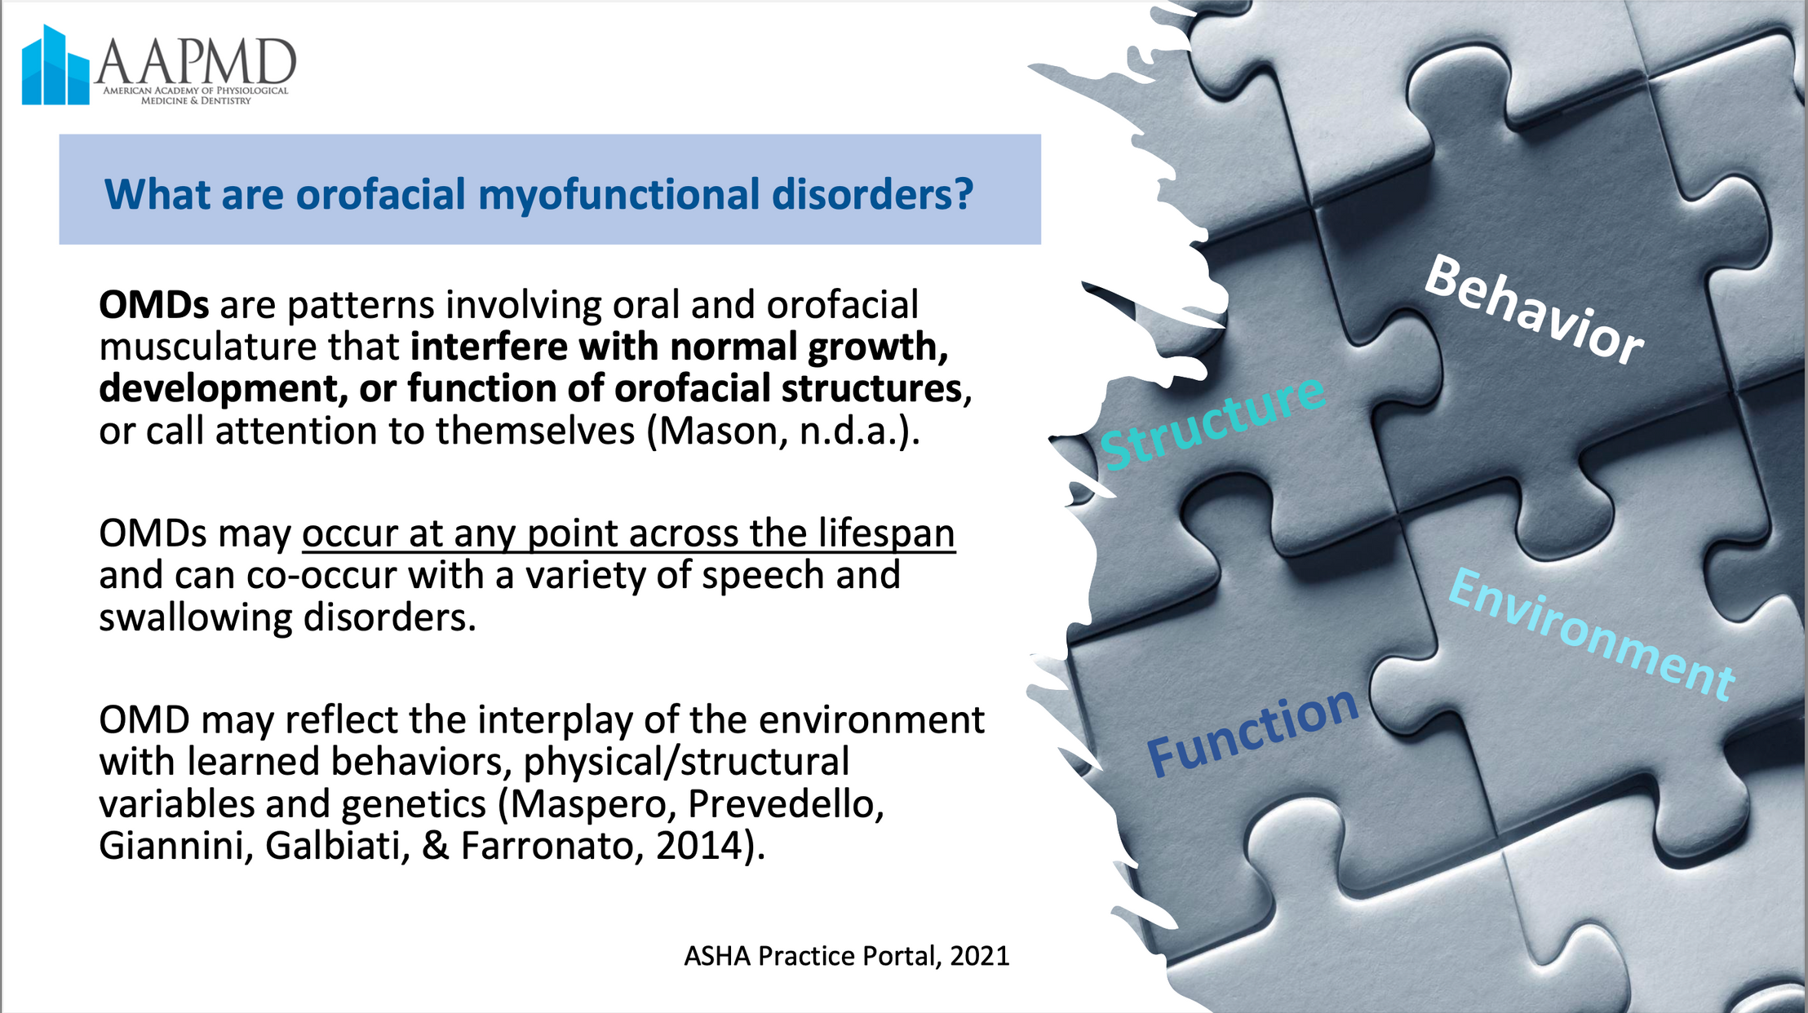

Slide 23
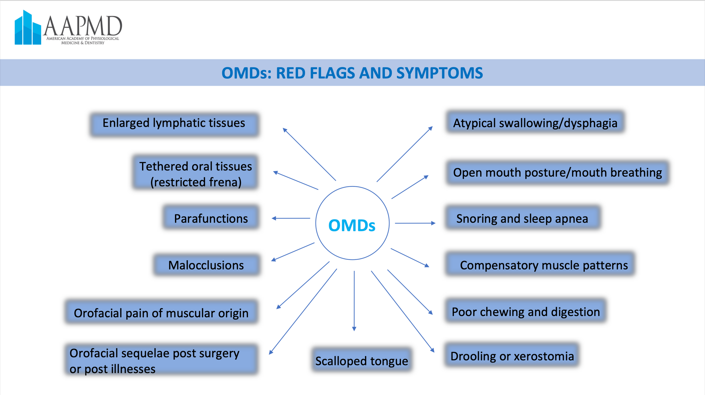

Slide 24
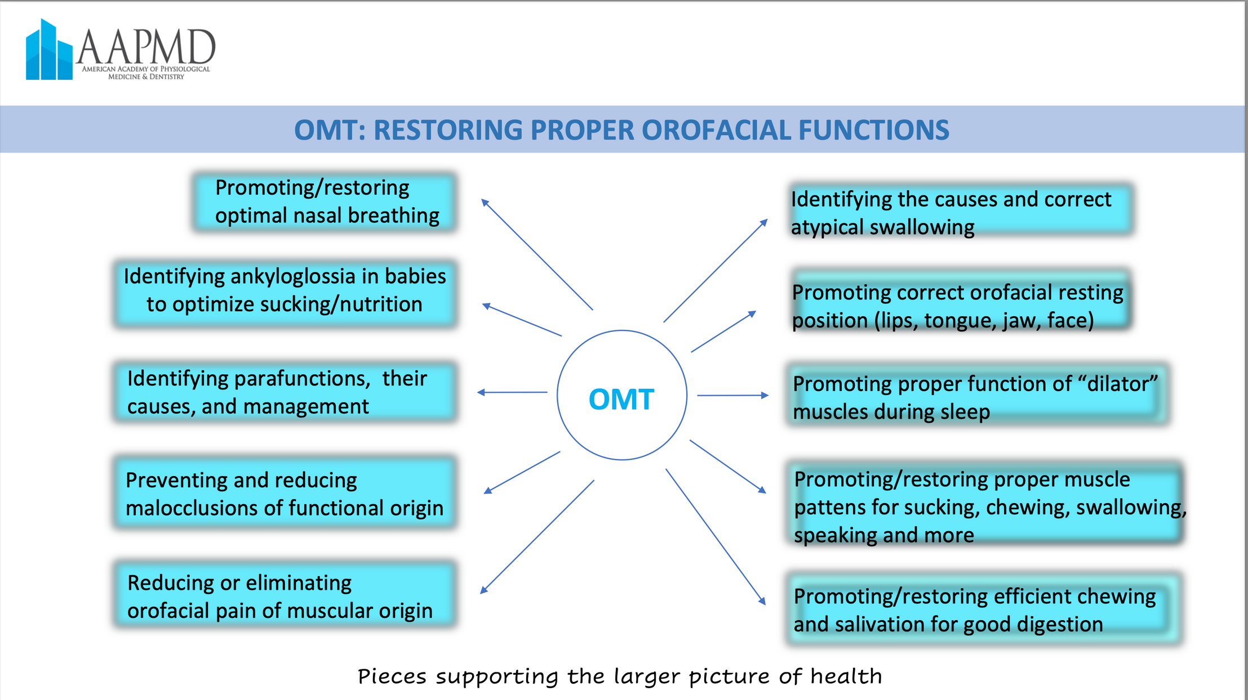

Slide 25
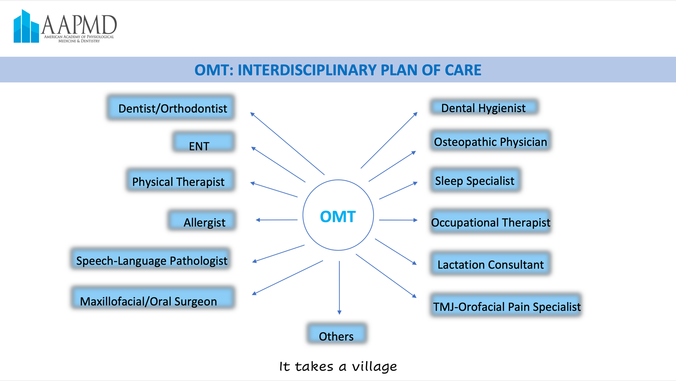

Slide 26
PHYSICAL THERAPY
ROLE IN THE COLLABORATIVE APPROACH TO AIRWAY MANAGEMENT

Slide 27
BEHAVIOR
Physical Therapy & Airway
Behavior is the way in which an animal or person acts in response to a particular situation or stimulus. Our repetitive behavioral patterns determine how well we function. Airway Centric Physical Therapist’s educate and train patient’s how best to maximize behavioral patterns in the following areas:
POSTURE
Improving postural alignment reduces stress on our joints, increases core stability and allows for efficient diaphragmatic breathing maximizing cognition and reducing fatigue. Proper posture balances our autonomic nervous system.
ERGONOMICS
Improving how we position and support oneself at our workstation, in bed and during other repetitive tasks will allow for proper rest and recovery in addition to reducing strain on our system.
BODY MECHANICS
Increasing awareness and execution of positioning during activities such as bending, lifting, squatting, and other repetitive activities reduces the chance of injury and decreases healing time.
BREATHING MECHANICS
Utilizing an appropriate diaphragmatic breath either at rest or during high intensity activities provides high quality gas exchange reducing fatigue and providing the appropriate coordination to perform higher level activities.

Slide 28
Physical Therapy & Airway
Management of the Musculoskeletal System
The ability for the respiratory system to provide efficient oxygen delivery and CO2 removal allowing for restorative sleep and daily function relies on the health of the entire musculoskeletal system. An airway centered physical therapy program evaluates and treats the entire body system which includes:
  The Cranial Vault
  The Cervical Spine
  Stomatognathic System (Jaw, Tongue, Lips, Vellum, Pharyngeal Complex, Vocal Folds/Glottis)
  Cranial Nerves
  Thoracic Spine, Ribcage and Diaphragm
  Pelvis and Pelvic Floor Musculature
  The Lower Extremity and Feet
  * Vestibular and Visual System
  Physical Therapists use a combination of hands-on techniques and prescriptive exercises to evaluate and treat dysfunction in these regions to ensure restoration of efficient function
The vestibular and visual system often plays a role in driving dysfunction in the musculoskeletal system and requires attention

Slide 29
Physical Therapy & Airway
Collaboration
Airway Centered Physical Therapists support the airway team in the following areas:
Below are some of the dysfunctions found requiring referral to the airway team:
  Malocclusion, crossbites, open bites, gum recession,
  Ankyglossia, tongue or lip restrictions, poor tongue control (ENT, Dentist, Myofunctional Therapist)
  Dysfunctional swallow (ENT, Myofunctional Therapist)
  Hearing loss, tinnitus (Dentist, ENT)
  Balance and gait disturbances (Dentists, Neurologist)
  Cranial Nerve Dysfunction (Neurologist)
  Sleep Disorders (Dentist, Sleep Medicine Physician, Psychiatrist)
  Inflammatory Conditions (Functional Medicine Physician, Nutritionist, Allergist)
  Nasal Obstruction (ENT, Plastic Surgeon, Dentist)

Slide 30
Physical Therapy & Airway
Collaboration
Airway Centered Physical Therapists support the airway team in the following areas:
Support for patients going through airway expansion and/or orthodontics
    reduce strain from appliance using hands-on and therapeutic exercise interventions to cranial, cervical and mandibular complex
    communicate changes in pain, gait, movement and balance to inform dentists how adjustments to patients’ appliance may improve compliance and outcomes
  Support patients with visual, auditory and vestibular dysfunctions related to an imbalance of their autonomic nervous system.
    Provide interventions to improve sensory processing
    Refer to appropriate professionals (ENT, Optometrist, Audiologist)

Slide 31

WHAT MORE CAN YOU DO?
RESEARCH COLLABORATIONS

Slide 32

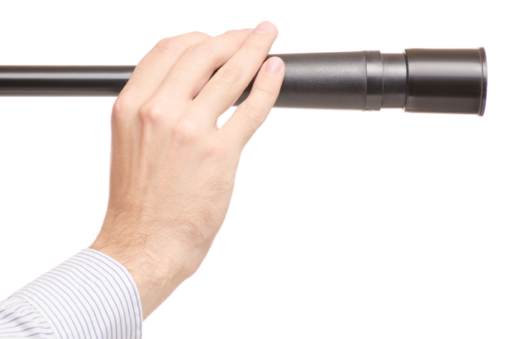

BREATHE
OUTLOOK
on demand
Join
THE
BREATHE
Us!
INSTITUTE
WELCOME TO A FIRST OF ITS KIND GLOBAL, MULTI-CENTER RESEARCH COLLABORATIVE!
WHY DO RESEARCH ?
EMPOWERS NEW DISCOVERIES
INFORMS CLINICAL BEST PRACTICES
IMPROVES PATIENT OUTCOMES
WANT TO PARTICIPATE IN RESEARCH?
JOIN IN OUR IRB APPROVED STUDIES
UNDERSTAND BASIC STATISTICS
REFINE YOUR DATA GATHERING SKILLS
HOW TO CRITICALLY READ A RESEARCH ARTICLE
DEVELOP CRITICAL AND ANALYTICAL THINKING
LEARN TO SPOT/AVOID FLAWS IN STUDY DESIGN
UNDERSTAND HOW BIAS CAN AFFECT DATA
LEARN SYSTEMATIC STRATEGIES TO REDUCE RESEARCHER BIAS AND MAXIMIZE OBJECTIVITY
IF YOU WANT TO TEST WHAT YOU THINK YOU KNOW OR IF YOU WANT TO LEARN HOW TO LEARN, THIS SECTION IS FOR YOU...

Slide 33
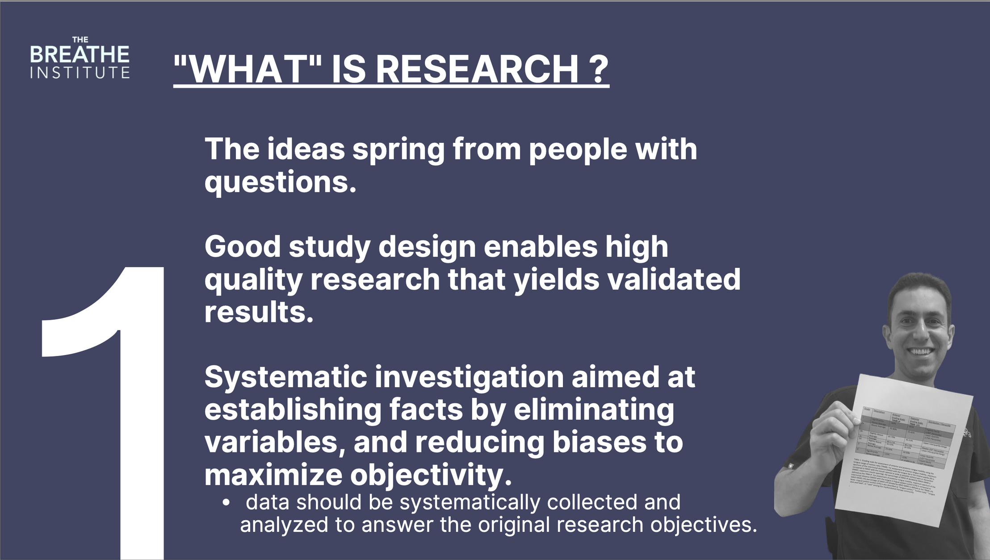

Slide 34
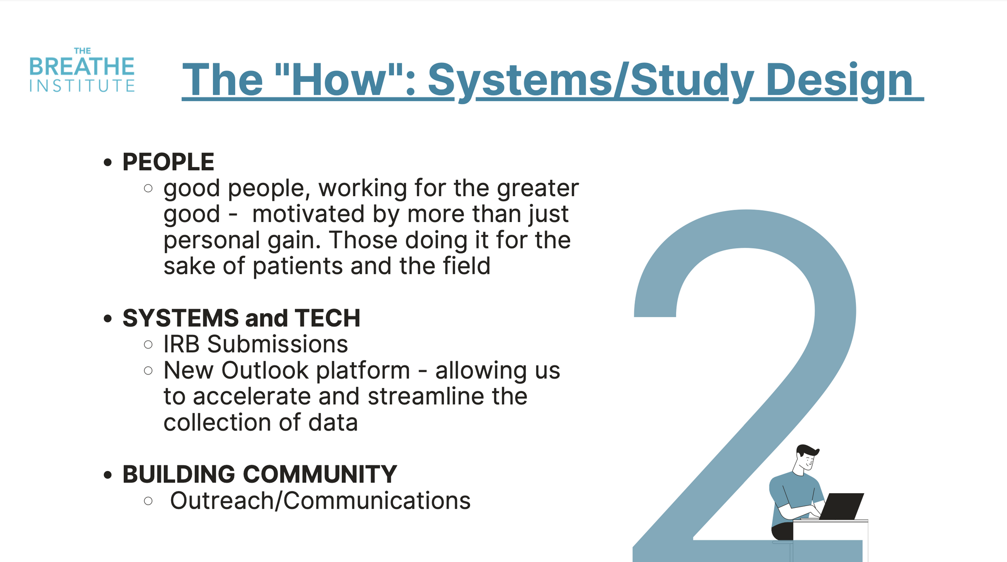

Slide 35
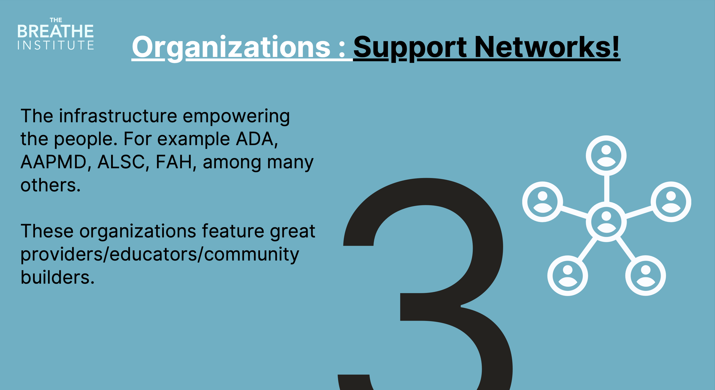

Slide 36
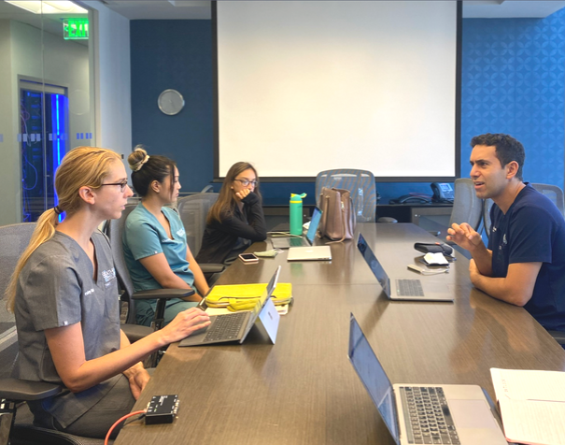
THE
BREATHE
TAKE A LOOK BACK TO SEE HOW FAR WE HAVE COME, AND PROJECT A LOOK FORWARD AS WE MOVE TOWARDS THE GOAL OF TRUE INTERDISCIPLINARY COLLABORATION ACROSS THE BOARD AMONG ALL OUR COLLEAGUES.
OUTLOOK
Join
Us!
- Dr. Soroush Zaghi
JOIN IN ONE OF THESE STUDIES
Medical Director, The Breathe Institute
LIP TAPING AS AN EVALUATION OF NASAL BREATHING:
WORKING TOWARD A FUNCTIONAL DEFINITION OF ANKYLOGLOSSIA:
DENTAL ORTHOPEDIC REMODELING:
LINGUAL FRENULOPLASTY AND MYOFUNCTIONAL THERAPY:
A multi-center cross sectional cohort study of time to failure for exclusive nasal breathing.
A cross-sectional study focusing on the identification of compensations during assessment of tongue mobility.
A retrospective and/or prospective study assessing objective outcomes based on CT findings and patient reports.
A non-randomized prospective controlled study using pre- and post- operative sleep studies to evaluate treatment efficacy.
Deepen your understanding of the scientific method/research process
Become a critical consumer of information / develop critical and analytical thinking
Propel research forward through a collaborative care pathway with a focus on:
breathing , tongue posture and tongue-ties, and dental/orthopedic remodeling
One major factor that limits the progress we can make is the high degree of confirmation bias that can make it difficult to reach consensus when ideas clash between team members who see the problem from different perspectives. In this session, we will explore biases that are present all around us in clinical practice and real-life, and discuss the role of high-level clinical research in the form of systematic investigation to help us learn, unlearn, rethink, and make new discoveries. Participants will learn about research methods and be invited to participate in one of our IRB-approved research projects, on topics ranging from mouth taping and nasal breathing, tongue-tie surgery, myofunctional therapy, and dental orthopedic remodeling. If you want to get involved in research.
REGISTER at: AAPMD.org or TheBreatheCourses.com

Slide 37
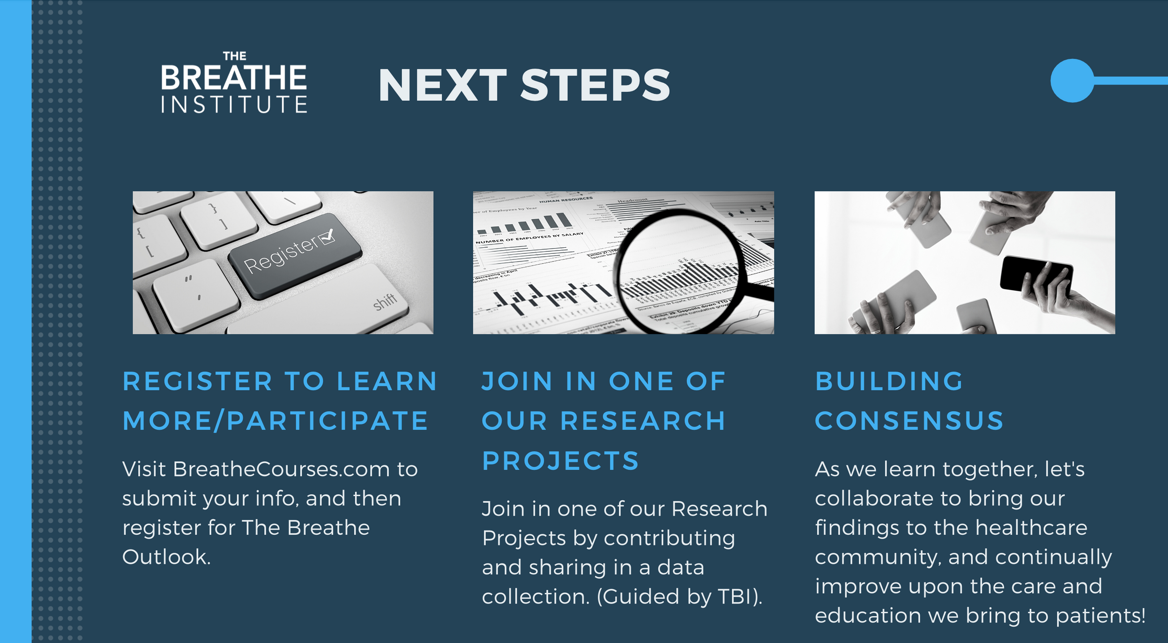

Slide 38
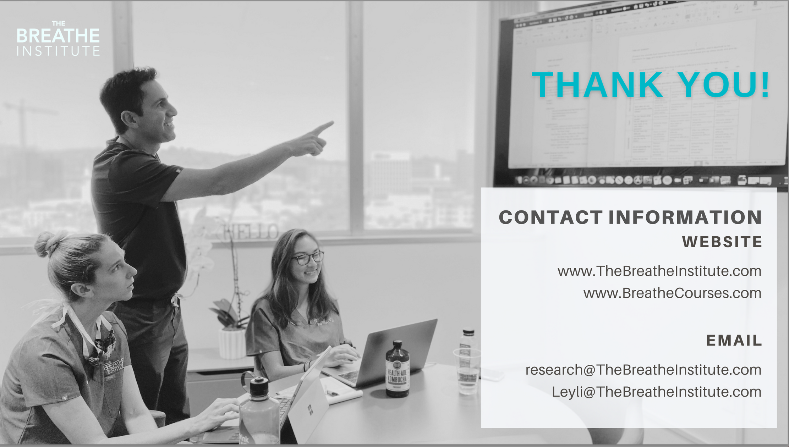
www.aapmd.org
info@aapmd.org

Slide 39



IN CONCLUSION
The muscles of the face, mouth, and throat must be in balance to work together in harmony
comprehensive assessment for orofacial myofunctional disorders is necessary to determine if supportive therapy can enhance treatment
Collaboration with sleep medicine dentist or physician is vital to address patient's needs

Slide 40

When you Know
better you do better
Maya Angelou

